Slide 1

Computer Systems Fundamentals
H175 34
Lecture 8
Software Layers continued

Slide 2
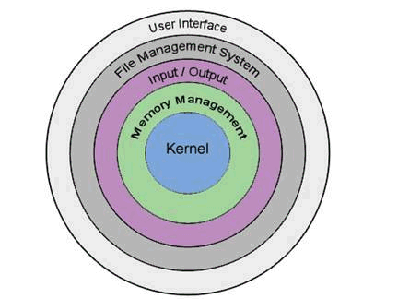


The Input-Output Layer
The Input/Output Layer manages communications between the CPU and peripherals (disk drives, keyboard, mouse etc)
If another layer requires access to a device, e.g. sending data to the printer, a request is sent to the I/O layer

Slide 3
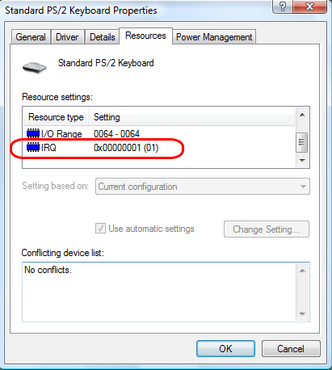
Interrupting
Each device will have an interrupt priority, and it interrupts the CPU when it is ready to send or receive data
This interrupt signal is sent to the Kernel, which then directs the correct I-O process to handle the request

Slide 4
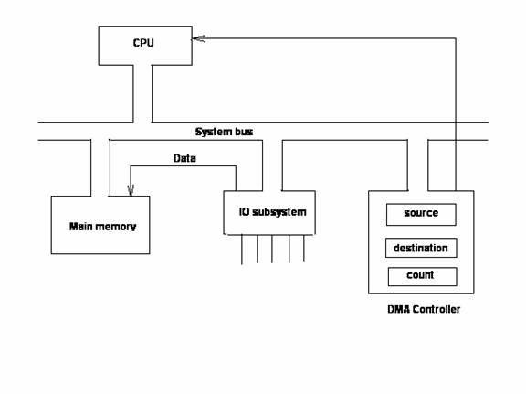
Interrupt Service Routine
When an interrupt request reaches the CPU, it causes the CPU to interrupt the task that it was doing and change to another routine -an interrupt service routine (ISR)
Once an IRQ is accepted by the CPU, it must identify the source of the request and locate the appropriate ISR in memory. The PIC (programmable interrupt controller) identifies the IRQ responsible for the interrupt
When the ISR is completed, the CPU returns to the program it was executing and resumes its previous task

Slide 5


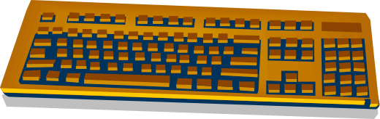

Character I-O
This is where data is transferred one character at a time
Usually this is an eight-bit transfer on each interrupt
Even large quantities of data are transferred one byte at a time
This is used for the keyboard, mouse, joystick, com ports and printer

Slide 6
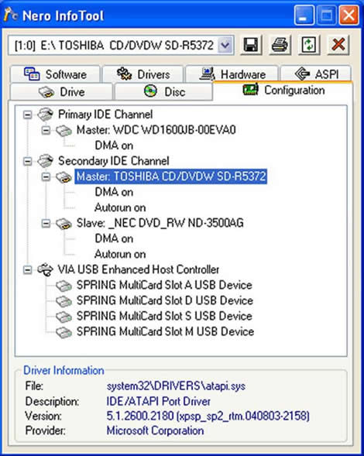
Block I-O
Block I-O is used when larger amounts of data (normally 2 kb) are read into or written back out from memory
The data is transferred in blocks into memory, then transferred out to the device using Direct Memory Access (DMA)
Another interrupt is sent when the device has finished transferring the data

Slide 7
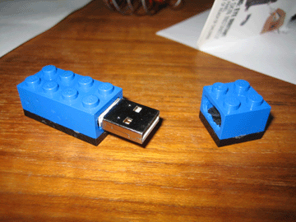

Device Drivers
A device driver is software that controls a particular device attached to a computer
Device drivers are often specific to a particular release of an operating system, e.g. Windows 98 device drivers may not work with Vista
Many device drivers are nowadays built into the operating system – for example, USB flashdrives

Slide 8
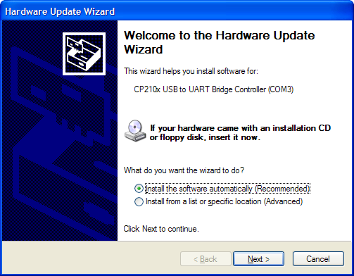
Device Drivers
More complex devices often require their own, dedicated device drivers which must be installed by the user

Slide 9
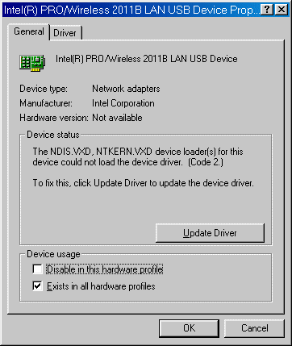
Device Drivers
Device driver files have the extension DLL or EXE. VXD is a virtual device driver
A virtual device driver handles software interrupts from the system, and are used to monitor the status of a hardware device that has variable settings
Device drivers are stored on the Hard Disk and are loaded into RAM along with the OS on bootup

Slide 10
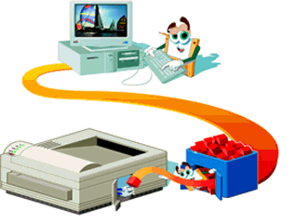
Device Management
The Input - Output system controls and shares access to devices; where several processes require it, the IO system will place the jobs in a queue
Jobs are then released to the peripheral when it becomes available. The queued jobs are held in a spool file (the most common example of this is a print spooler)
We can control the operation of the print spooler from the user interface – e.g. to change the order, or cancel a job
From www.maran.com

Slide 11

The Memory Management Layer
The Memory Management layer shares the physical memory of the computer between processes and programs
Usually there is not enough physical memory available, so Virtual Memory is used
Memory already allocated out is protected against access by other programs

Slide 12
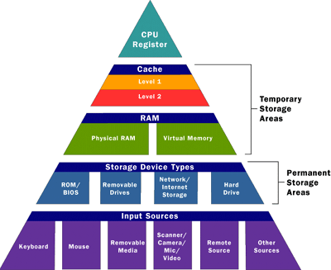
Physical and Virtual Memory
In modern systems, many programs can be running simultaneously, all of which require memory
Each memory segment is tagged with information about which process owns it, so it cannot be used by anything else
Any attempt to use a tagged segment will be prevented
As there is no effective limit on the number of programs that can run simultaneously, there will never be enough physical memory – so Virtual Memory is also used
From www.howstuffworks.com

Slide 13
Paging
Physical memory is split into a number of logical pages; when a program requires memory, it is allocated a number of pages
If all the available pages are already in use the memory management system looks for a page that it can reclaim
This is normally done by choosing the “oldest” page (least recently loaded) or the one which has been idle the longest (least recently used)
The page is then swapped out to a file on the Hard Disk (the Swap File)
Pages are then swapped in and out between RAM and the HDD as required

Slide 14
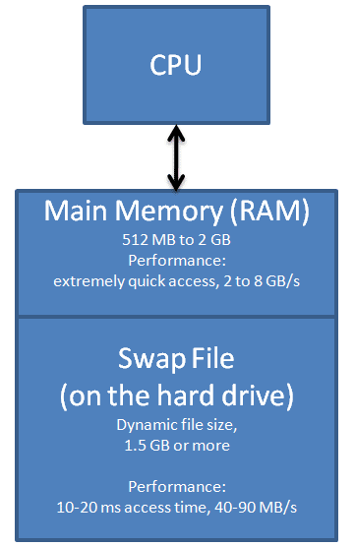
Swap File
The Memory Management Unit (MMU) automatically translates the logical addresses used by programs into the physical addresses where the information is actually stored
The set of physical memory locations is known as the memory space
The set of virtual memory locations is known as the address space

Slide 15
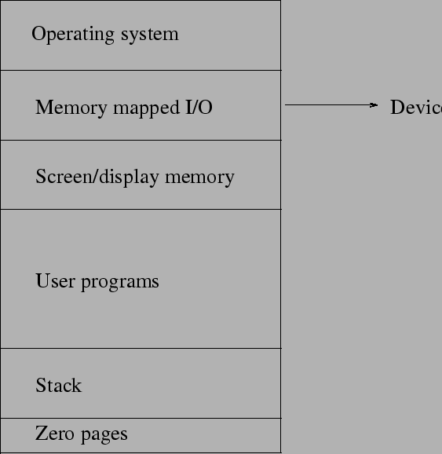
Memory Mapping
Mapping between the address space and the memory space is carried out by means of a page table
Memory addresses come in two parts - the page number, and an offset within that page
The MMU uses the page number to look up the page table, which holds information about that page number, including whether it is currently present in memory

Slide 16
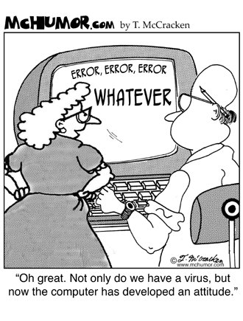
Segmentation
The biggest disadvantage of paging is that all the pages are the same size; this is wasteful if the page sizes are large, but they will need swapped a lot if they are small
Segmentation divides up memory into blocks of variable sizes. Details of the segments allocated to various processes are stored in a segment table

Slide 17
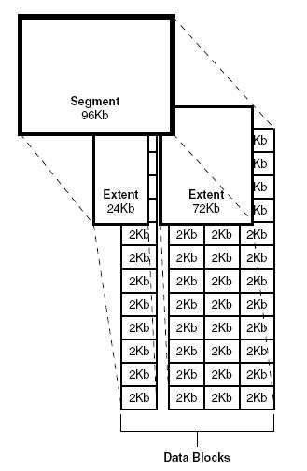
Combinations
Most systems use a combination of segmentation and paging - each variable-length segment is made up of several fixed-length pages with its own page table
Each entry in the segment table contains protection bits, indicating whether that segment can be read or written to by other processes
From www.onlineappsbda.com

Slide 18
Allocation Algorithms
First Fit algorithm - the allocator keeps a list of free blocks and scans along the list for the first block that is large enough to satisfy the request
Buddy system - the allocator will only allocate blocks of certain sizes, and has many free lists, one for each permitted size. When the allocator receives a request for memory, it rounds the requested size up to a permitted size, and returns the first block from that size's free list

Slide 19
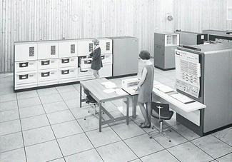
Thrashing
Thrashing is used to describe where the workload cannot be effectively held within physical memory, and constant data swapping, to the detriment of system performance, occurs
The term was first used for tape operating systems to describe the sound the tapes made when data was being rapidly written to and read from them
© 40 Years of Computing at Newcastle - IBM System 360 Model 67 c.1969
IBM 360/67 Time sharing system
This model was particularly prone to thrashing!

Slide 20
The Kernel
The kernel is the most central, and most protected, layer of the Operating System
The kernel is responsible for
multi-tasking
process control
error handling
interrupt management

Slide 21

Two Types of Multi-tasking
All modern operating systems support multi-tasking - the computer can handle several processes simultaneously
There are two distinct types of process management –
  Co-operative and
  Pre-emptive

Slide 22
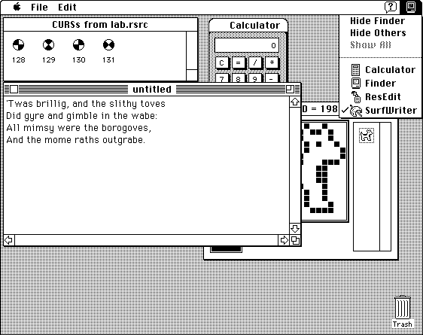
Co-Operative Multitasking
Each process controls the processor for as long as it needs it
It can permit other programs to use it temporarily
Older versions of both Microsoft Windows and Mac OS implemented cooperative multi-tasking
Cooperative multi-tasking depended on the co-operation of the process in question, to hand back resources to other processes
Badly designed software often led to system freezes or hang-ups
From http://developer.apple.com/documentation/mac/Processes/Processes-13.html with notes on co-operative multitasking

Slide 23
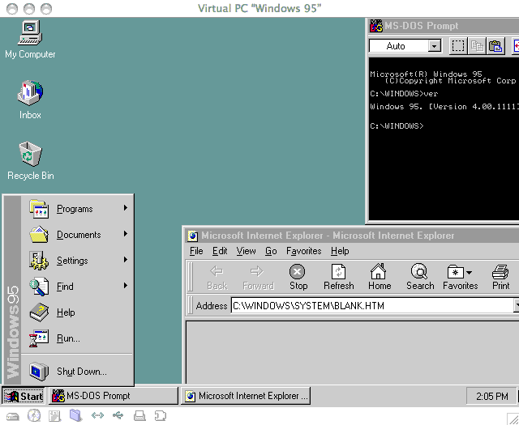
Pre-emptive Multitasking
Preemptive multi-tasking uses a scheduler to allocate out processor time
Each process is allocated a regular time slice
As different processes have different needs, the system will assign a priority to each process
This is the first true pre-emptive OS from Microsoft – Windows 95. See http://www.kernelthread.com/mac/vpc/win.html for more interesting stuff on multitasking systems and older operating systems.

Slide 24
Process States
Running processes can be either –
    waiting for input or output (I/O bound)
    fully utilising the processor (CPU bound)
  I/O bound processes can be blocked until a response arrives - other processes can have access to the processor in the meantime. When the data arrives, it triggers an interrupt, allowing the blocked process to resume

Slide 25
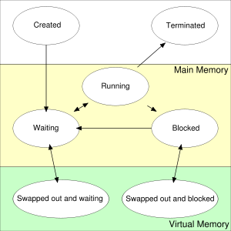
The 4 Process States
Running: a currently executing process
Ready (Waiting): the process is ready to be run
Blocked: waiting for a specific event to occur, for example waiting for input from the user
Terminated: the process has finished its run
From wikimedia commons

Slide 26
Process Sub-states
Ready Suspend: the process has been swapped out into Virtual Memory, to free up main memory for another process
Blocked Suspend: the process is swapped out of main memory because it is in a wait state

Slide 27
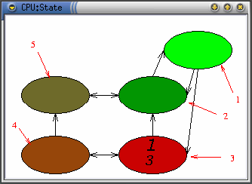
Process Monitoring Software
Running process
Ready process
Process blocked waiting for some event
Blocked suspended process
Ready suspended process
In the picture, process 1 is blocked
From http://visualos.sourceforge.net/docs/html/Manual-en/x223.html

Slide 28
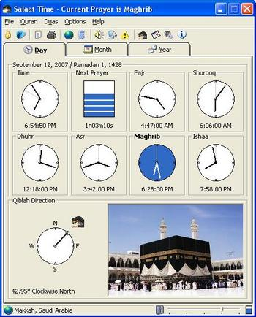
IPC Mechanisms
Clipboard shares data between applications
Dynamic Data Exchange (DDE) is a protocol that allows applications to exchange data between applications in different formats
Object Linking and Embedding (OLE) is used for compound documents, e.g. embedding an Excel chart in a Word document
http://www.vista-files.org/programs/salaat-time/salaat-time.html

Slide 29
IPC Mechanisms
File mapping uses a pointer to attach another file, e.g. sending an e-mail attachment in Outlook Express
Anonymous pipes are used to transfer data from one process into another
Named pipes are similar, but used to transfer data between unrelated processes or processes on different computers
Remote Procedure Call (RPC) allows applications to call functions from a central code repository, for example using dll library files
Winsock communicates with other socket implementations on other types of systems, in particular for internet connections

Slide 30
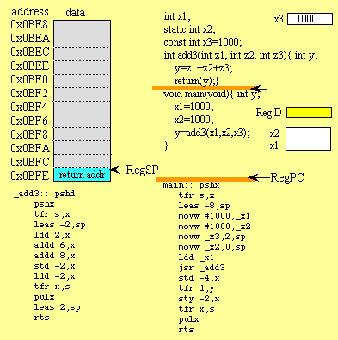
Interrupts
In the I/O layer we saw how hardware could trigger a processor interrupt; there are also software interrupts which do the same thing
There are typically 256 types of interrupt in a modern system; 16 of these are hardware-generated, 240 are software-generated
In addition, there are 16 more software interrupts which can simulate the hardware ones
From http://users.ece.utexas.edu/~valvano/assmbly/stack.htm - what happens after an interrupt is triggered

Slide 31
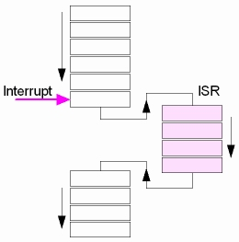
Interrupt Handling
The kernel handles all of the interrupts, exceptions, system service calls and virtual memory management
Like the hardware interrupts, some of the software interrupts have higher priority than others
When an interrupt occurs, it is handled by an interrupt service routine (ISR)
The kernel includes ISRs for many system interrupts such as the system clock and DRAM refresh
Other ISRs are provided by device drivers

Slide 32
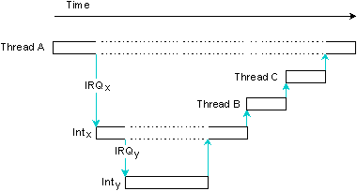
Masked Interrupts
In modern operating systems, low-priority interrupts are masked (blocked) while a higher-priority interrupt is being processed
A high priority interrupt will, however, take precedence over a lower priority interrupt
Thread A is running. Interrupt IRQx causes interrupt handler Intx to run, which is preempted by IRQy and its handler Inty. Inty returns an event causing Thread B to run; Intx returns an event causing Thread C to run. From http://www.bitctrl.de/qnx/qnx6_sysarch/qnx6_sysarch_2b.shtml

